Slide 1
[Ethan Zhang]
[Ethan Zhang]
Portfolio
[JANUARY ]
[NAME OF PRIMARY SCHOOL[

Slide 2

About me
[Ethan Zhang]
My name is Ethan Zhang and I am 12 years old this year. I started learning robotics with the Lego Mindstorms together with block-based coding when I was in Primary 2. I enjoy working on different structures and robots, designing and building them to automate routine daily tasks in my life.
Learning robotics helped me to solve real world problems. I was eager to explore beyond block-based coding. This spark my interest in learning python, text-based coding. I wanted to write codes to help me solve my math problem sums without the use of the pen and paper.
Beyond honing my python fundamentals, I wanted to create games that was beneficial to students. I leant how to use Pygame and created different games that my friends could compete and challenge one another.
I have documented my journey in robotics, coding,
Innovation and STEM.
2
Notes:
Poppins Light – 18 size

Slide 3
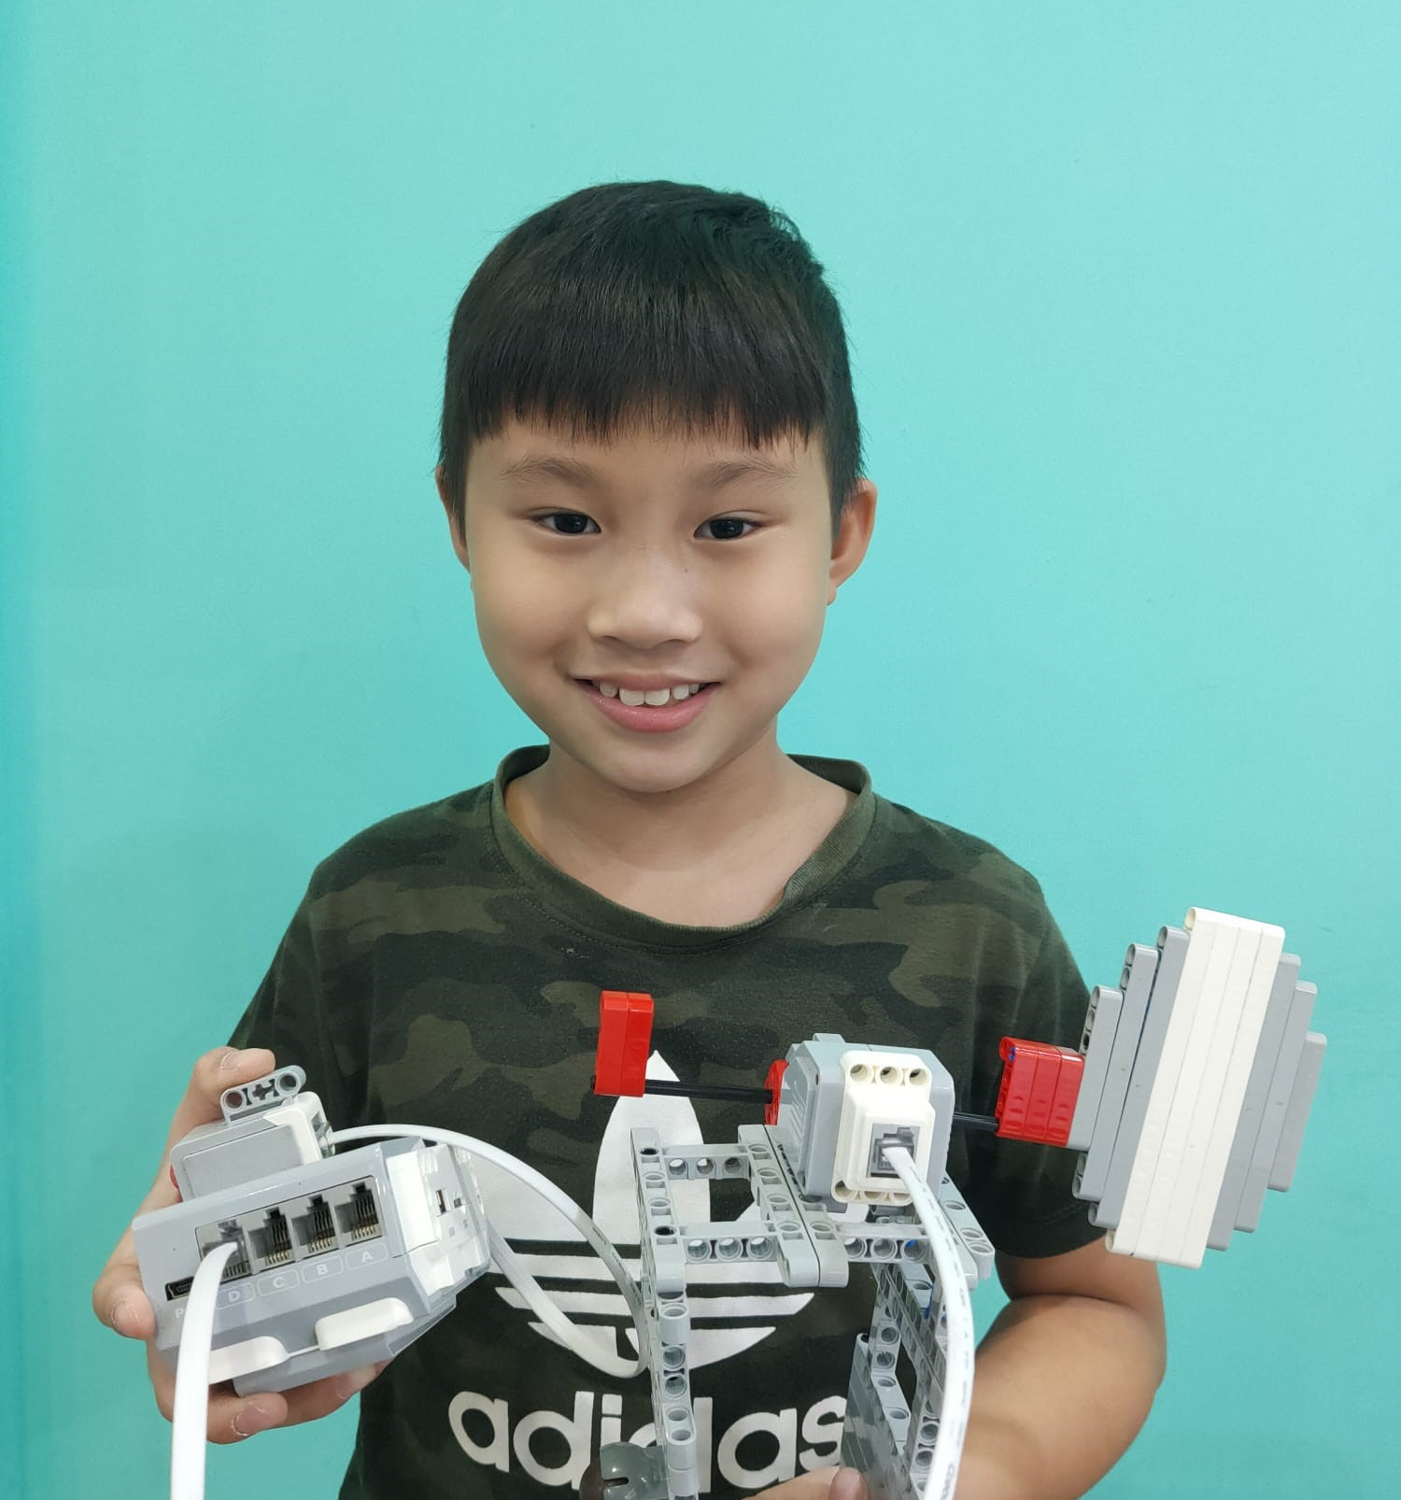
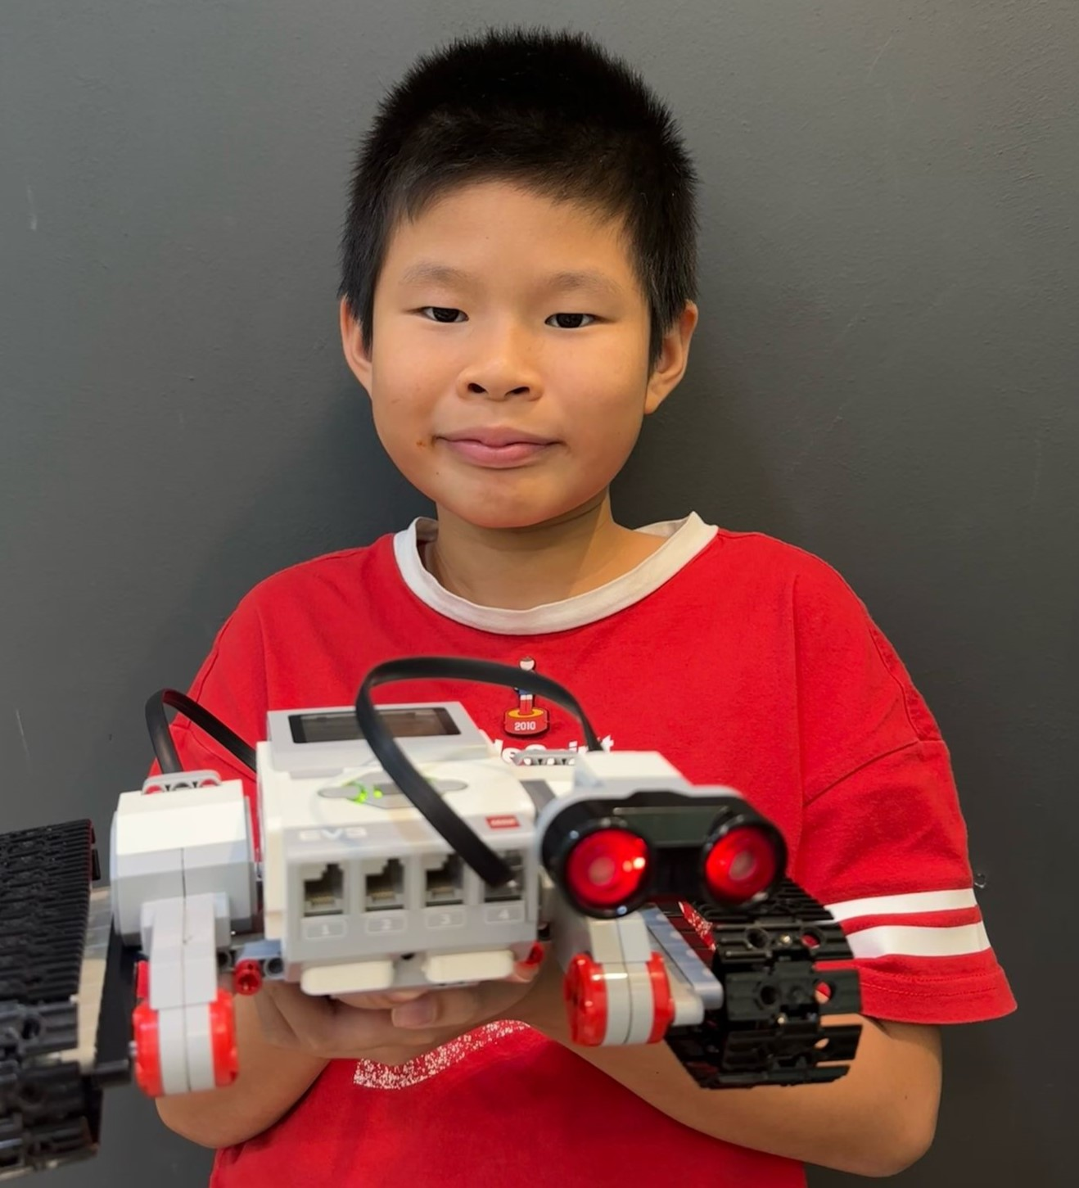
[Ethan Zhang]
What I’ve accomplished
Foundation building with robotics and block- based coding - Conditionals
[Project 1]
I learnt how to use the LEGO technic parts to create different designs.
Using the coding concept of conditionals (if-else), together with different sensors, I coded my designs to do certain actions only if a specific condition is met.
Among many other projects, I created a ping pong racket that hits the ball if the touch sensor is activated
[Project 2]
I built a LEGO-based tractor model designed to simulate real-life functionality. It uses an ultrasonic sensor to detect obstacles and automatically stop when objects are within a threshold distance that I configured. This demonstrates the potential advantages of automation and smart technology in modern farming.
Project 1 – Touch activated catapult
Project 2 – Ultrasonic activated Tractor
3
Notes:
Poppins Light – 18 size

Slide 4
Process Flow Chart
[Ethan Zhang]
Need a stable shooter that will push bullets out and retract
Define Problem
Design of shooter must be accurate
Code to push bullets out and retract must be full proof
Ideate Approach
#604A7B
Use of gears in design for security
Coding concept of while loops with colour sensor
#254061
Create
Solution
#C00000
4
#F79646

Slide 5
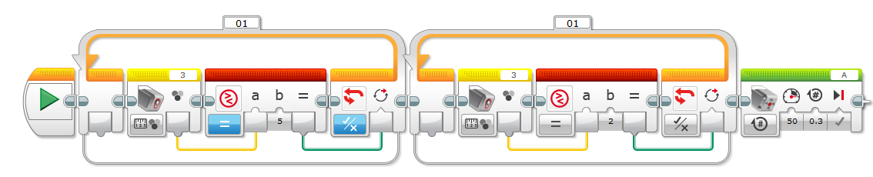
Logic Flow Chart
[Ethan Zhang]
Colour activated shooter
Step 1: Identify an approach
Condition 1
Condition 2
Action
Step 2: Breaking down of problem into a series of steps
Colour Sensor
Condition
Colour Sensor
Condition
Shoot
#604A7B
Step 3: Creating a solution
#254061
Loop While
Loop While
Sensor activated
Reading=5
Sensor activated
Reading =2
Shoot
#C00000
5
#F79646

Slide 6
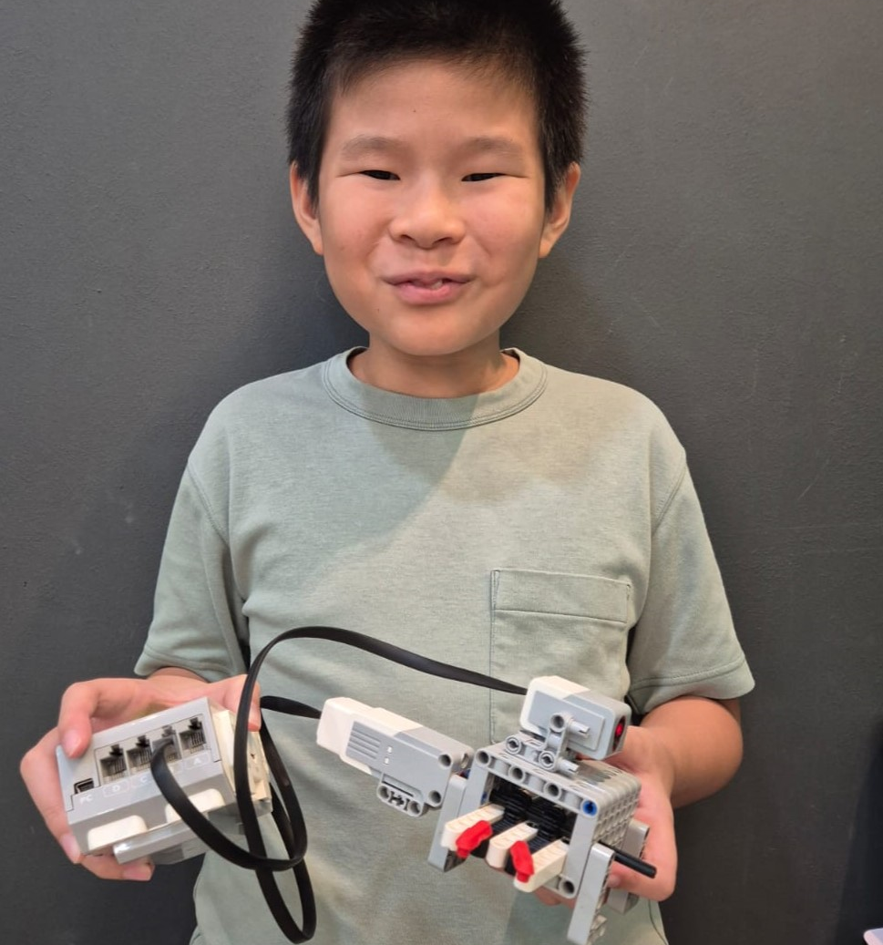
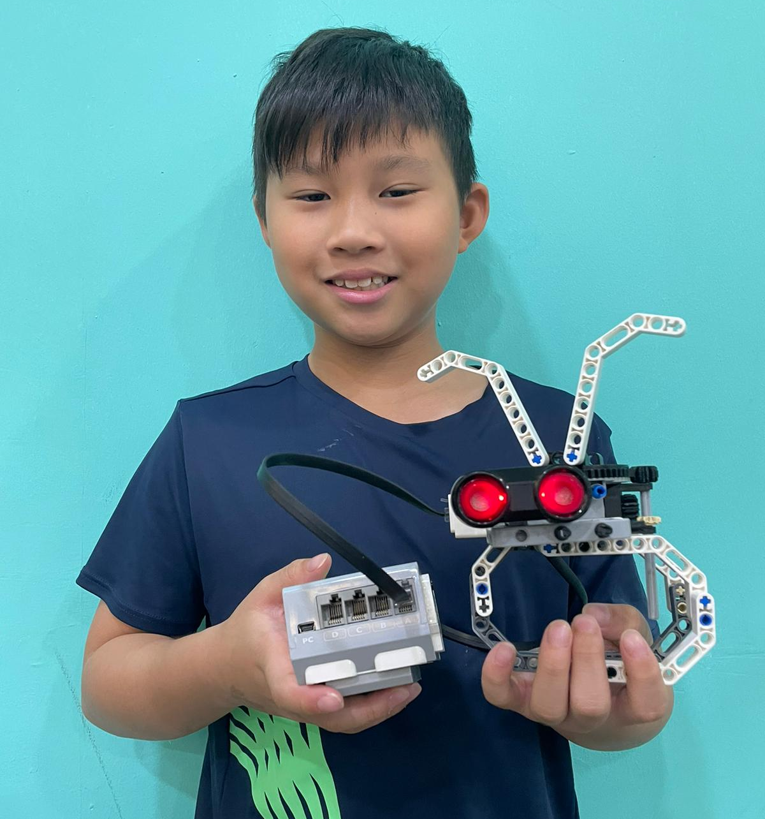
[Ethan Zhang]
What I’ve accomplished
Problem Solving with robotics and block- based coding – Nested While loops
[Project 3]
Having played at the arcade frequently, I decided to use the concepts of conditional statements, colour detection and output controls to create a secure and precise shooter that fires a shot when the colour sensor detects 2 specific colours in the coded order.
[Project 4]
Project 3 – Colour activated shooter
Project 4 – Automated rabbit head
6
Notes:
Poppins Light – 18 size

Slide 7
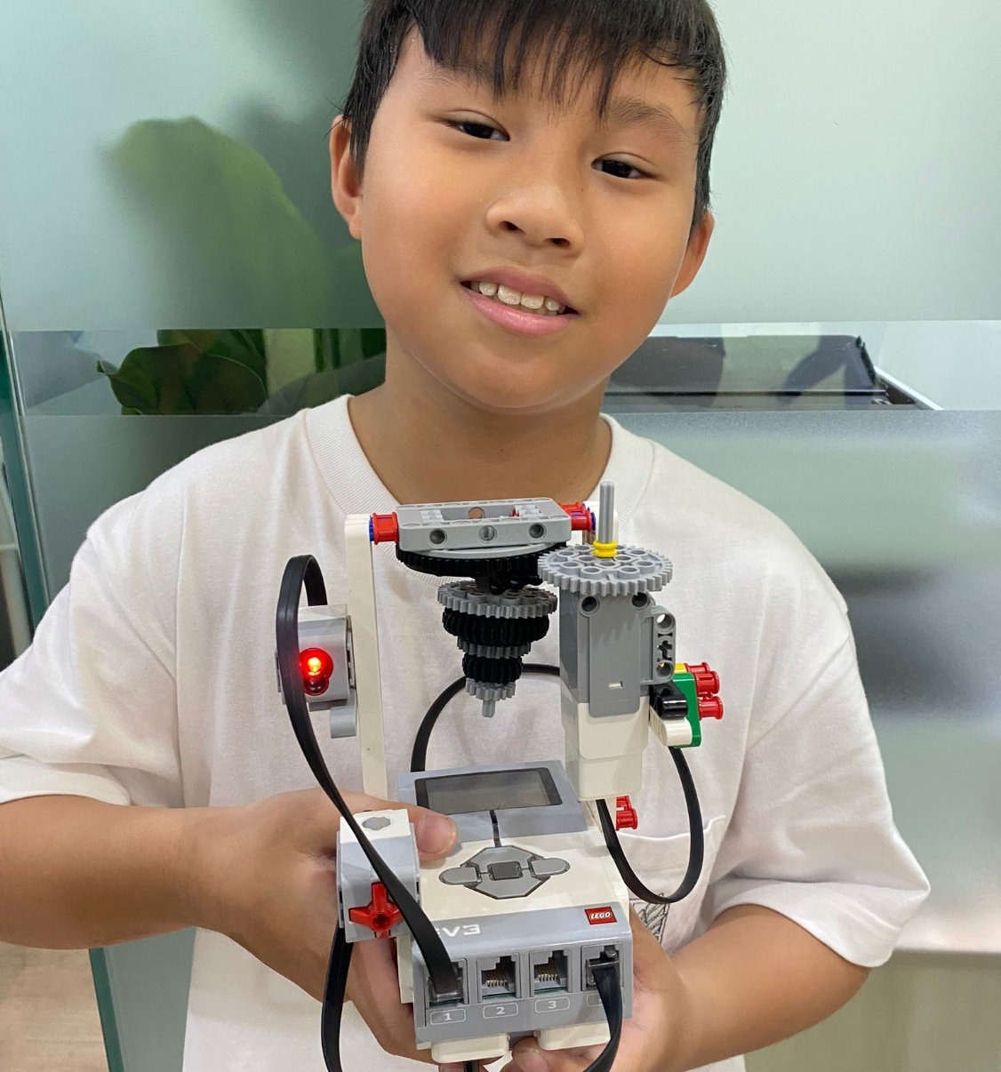
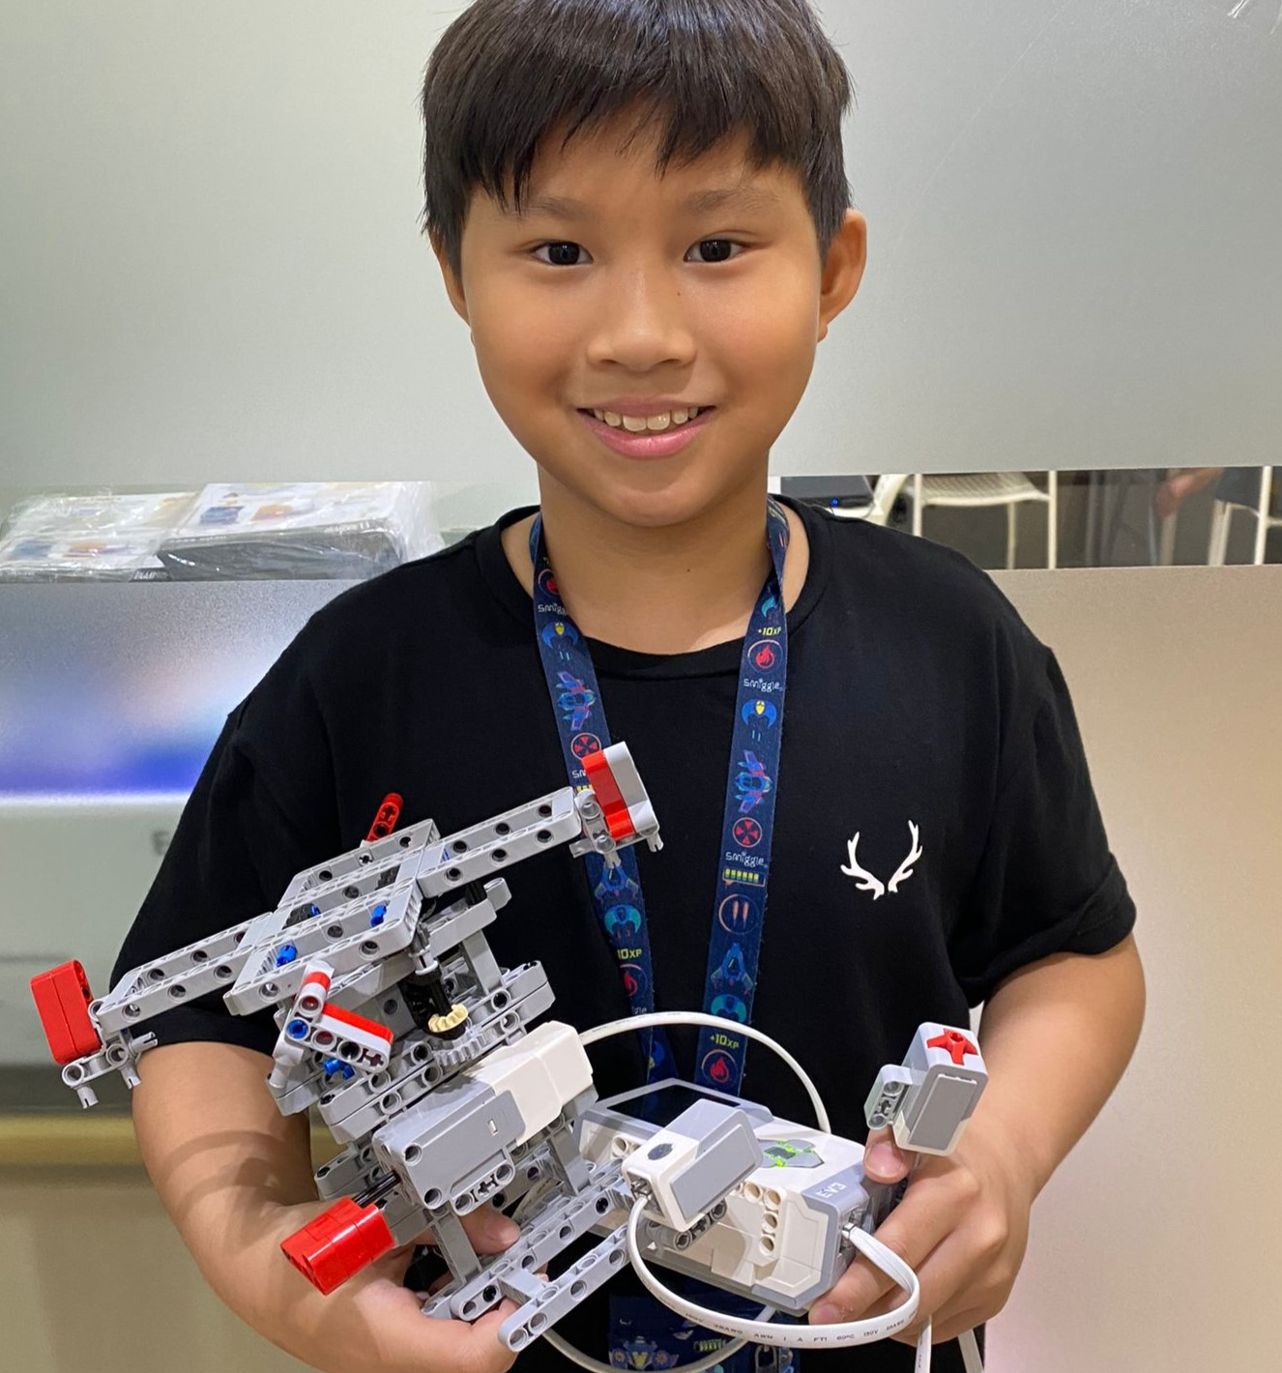
[Ethan Zhang]
What I’ve accomplished
Problem Solving with robotics and block- based coding – Nested if else and variables
[Project 5]
Playing the top is my childhood game and I decided to recreate a sensor-controlled spinning top using LEGO technic parts and coded it to move when it is activated by a colour sensor. The direction it moves is controlled by the reading of the ultrasonic sensor. It is designed to enhance user engagement and ensures consistent gameplay with minimal effort needed for monitoring or control.
[Project 6]
I built a lego model of a merry go round that is fully automated to replicate how a real amusement ride would respond to inputs from sensors. The colour sensor is used to increase the rotation speed while the touch sensor slows it down to enhance user experience and safety.
Project 5 – Colour and ultrasonic sensor activated top
Project 6 – Colour activated speed increasing and touch activated speed decreasing merry go round
7
Notes:
Poppins Light – 18 size

Slide 8
[Ethan Zhang]
What I’ve accomplished
Business application with Python – Math Concept
Time Breakdown
I have written a Python program named time_breakdown.py to convert a user-input number of minutes into days, hours, and remaining minutes using floor division and modulo.
Step – By – Solution
1. Take the total number of minutes as input from the user.
2. Calculate the number of days by dividing the total minutes by (24 * 60) using floor division (//).
3. Calculate the remaining hours by finding the remainder when the total minutes are divided by (24 * 60) and then dividing by 60 using floor division.
4. Calculate the remaining minutes by finding the remainder when the total minutes are divided by 60 using the modulo operator (%).
5. Print the breakdown of days, hours, and minutes.
8

Slide 9
[Ethan Zhang]
What I’ve accomplished
Business application with Python – Math Concept
Time Breakdown
Start
1. Take the total number of minutes as input from the user.
2. Calculate the number of days by dividing the total minutes by (24 * 60) using floor division (//).
3. Calculate the remaining hours by finding the remainder when the total minutes are divided by (24 * 60) and then dividing by 60 using floor division.
4. Calculate the remaining minutes by finding the remainder when the total minutes are divided by 60 using the modulo operator (%).
5. Print the breakdown of days, hours, and minutes.
Get user input for minutes
Set days =
minutes // (24 * 60)
Set remaining_hours =
(total_minutes % (24 * 60)) // 60
Set remaining minutes =
minutes % 60
Output in format of breakdown
9
Stop

Slide 10
[Ethan Zhang]
What I’ve accomplished
Business application with Python – Math Concept
Time Breakdown
I have written a Python program named time_breakdown.py to convert a user-input number of minutes into days, hours, and remaining minutes using floor division and modulo.
Code
total_minutes = int(input("Enter the total number of minutes: "))
days = total_minutes // (24 * 60)
remaining_hours = (total_minutes % (24 * 60)) // 60
remaining_minutes = total_minutes % 60
print(f"{total_minutes} minutes is equal to {days} days, {remaining_hours} hours, and /{remaining_minutes} minutes.")
10

Slide 11
[Ethan Zhang]
What I’ve accomplished
Business application with Python – String Methods
Word Reverser
To create a Python script that takes a sentence as input and outputs the words in reverse order, preserving the original word content.
Features:
Accepts a full sentence as input.
Splits the sentence into individual words.
Reverses the order of the words.
Displays the reversed sentence to the user.
11

Slide 12
[Ethan Zhang]
What I’ve accomplished
Start
Get User Input
Word Reverser
START
Get User Input
The program asks the user to input a sentence.
This input is stored as a string variable.
Split the Sentence into Words
The program splits the input sentence into individual words.
This is done by breaking the sentence based on spaces, and the words are stored in a list.
Reverse the List of Words
The program reverses the order of the words in the list.
This is done by reversing the list using slicing.
Join the Reversed Words into a New Sentence
The reversed words are then joined back together into a single sentence.
Spaces are added between each word to form a readable sentence.
Output the Reversed Sentence
The final reversed sentence is printed on the screen for the user to see.
END
Split the Sentence into words
Reverse List of Words
Join Reversed Words into a New Sentence
Output the Reverse Sentence
13
Stop

Slide 13
[Ethan Zhang]
What I’ve accomplished
Business application with Python – String Methods
Word Reverser
text = input("Enter a sentence: ")
# Split the sentence into words
words = text.split()
# Reverse the list of words
reversed_words = words[::-1]
# Join the reversed words into a new sentence
reversed_sentence = ' '.join(reversed_words)
print("Reversed sentence:", reversed_sentence)
14

Slide 14
[Ethan Zhang]
What I’ve accomplished
Business application with Python – If-Else Concept
Right Triangle Checker for Geometry Class
I created a Python program named right_triangle_checker.py to check if a triangle with given side lengths is a right triangle. The program took user input for the side lengths and checked if the triangle satisfied the Pythagorean theorem – a² + b² = c²
15

Slide 15
[Ethan Zhang]
What I’ve accomplished
Start
Business application with Python – If-Else Concept
Get user input for side1, side2, side3
Right Triangle Checker
for Geometry Class
Sort side1, side2, side3 by its order such that side3 is the largest
1. Take the lengths of the sides of a triangle as input from the user.
2. Sort the side lengths in ascending order.
3. Check if the sum of the squares of the two shorter sides is equal to the square of the longest side.
4. If the condition is met, the triangle is a right triangle; otherwise, it is not.
5. Print whether the triangle is a right triangle or not.
Is side3 square equal to side1 square plus side2 square?
No
Yes
Output Not Right Triangle
Output Right Triangle
16
Stop

Slide 16
[Ethan Zhang]
What I’ve accomplished
Business application with Python – If-Else Concept
Right Triangle Checker for Geometry Class
# Get user input for the side lengths
side1 = float(input("Enter the length of side 1: "))
side2 = float(input("Enter the length of side 2: "))
side3 = float(input("Enter the length of side 3: "))
sides = [side1, side2, side3]
# Check if the triangle is a right triangle
sides.sort()
if sides[0]**2 + sides[1]**2 == sides[2]**2:
print("The triangle is a Right Triangle!")
else:
print("The triangle is not a Right Triangle.")
17

Slide 17
[Ethan Zhang]
What I’ve accomplished
Business application with Python – For Loop If Else
Name Initials Generator
To develop a Python script that takes a person’s full name and generates their initials in uppercase. For example, "John Ronald Reuel Tolkien" → "JRRT".
Features:
Accepts full name input (first, middle, last, etc.).
Trims any extra spaces.
Extracts and capitalizes the first letter of each name part.
Displays the result as uppercase initials.
18

Slide 18
Start
[Ethan Zhang]
What I’ve accomplished
Prompt user to provide
Full Name
Name Initials Generator
START
Get User's Full Name
The program asks the user to input their full name.
Split the Name into Parts
The program removes any extra spaces from the start or end of the name.
The name is then split into individual parts (such as first name, middle name, last name) based on spaces.
Start the Loop to Process Each Name Part
The program enters a loop that will process each part of the split name, one by one.
Check if the Part is Not Empty
Inside the loop, the program checks whether the part is not empty. This prevents processing empty strings (e.g., if there are multiple spaces between names).
Extract and Capitalize the First Letter of Each Part
If the part is valid (i.e., non-empty), the program takes the first letter of the part and converts it to uppercase.
This uppercase letter is then added to the final string of initials.
Continue the Loop
The loop continues for each part of the name. Each valid part's first letter gets capitalized and appended to the initials string.
Display the Final Initials
After processing all the parts of the name, the program outputs the final string of initials, which contains the first letter from each valid name part.
END
Loop Each Name Part
Is Name Part Empty?
Extract and Capitalize the First Letter of Each Part
No
Yes
Output Final Initials
19
Stop

Slide 19
[Ethan Zhang]
What I’ve accomplished
Business application with Python – For Loop If Else
Name Initials Generator
# Get user's full name
full_name = input("Enter your full name: ")
# Split the name into parts
name_parts = full_name.strip().split()
# Get the first letter of each part and capitalize it
initials = ""
for part in name_parts:
if part: # check if part is not empty
initials += part[0].upper()
# Display the initials
print("Your initials are:", initials)
20

Slide 20
[Ethan Zhang]
What I’ve accomplished
Business application with Python – For Loop
Shopping Cart
This project is a simple Python program that helps the user calculate the total cost of items in their shopping list. The user will input the number of items they are buying, followed by the name and price of each item. The program will then compute and display the total cost of all items.
21

Slide 21
TO DELETE - Flowchart A6
Start
[Ethan Zhang]
What I’ve accomplished
Get user input for number of items
Shopping Cart
Start
Ask for Number of Items
Initialize Total Cost
Start Loop for Each Item (For loop)
Repeat `num_items` times.
Ask for Item Name
Prompt “Enter the name of item [i+1].“
Store the input as `item`.
Ask for Item Price
Prompt "How much does [item] cost?“
Store it as `price`.
Update Total Cost
Output "Your total shopping cost is: ${total_cost:.2f}"
End
Initialize
Total Cost = 0
Start to Loop
Is End of Loop?
No
Get Item
Yes
Get Item Price
Output Total Cost
22
Update Total Cost
Stop

Slide 22
[Ethan Zhang]
What I’ve accomplished
Business application with Python – For loop
Shopping Cart
total_cost = 0
num_items = int(input("How many items are you buying? "))
for i in range(num_items):
item = input(f"Enter the name of item {i+1}: ")
price = float(input(f"How much does {item} cost? "))
total_cost += price
print(f"Your total shopping cost is: ${total_cost:.2f}")
23

Slide 23
[Ethan Zhang]
What I’ve accomplished
Business application with Python – If Else, While Loop
Simple ATM Simulation
A basic ATM program that lets users check balance, deposit, or withdraw money using a menu.
Uses a while loop to repeat the menu and if-else statements to handle user choices and balance logic.
24

Slide 24
Start
[Ethan Zhang]
What I’ve accomplished
Show Menu (1 – 4)
Simple ATM Simulation
User Input Choice
Start
Show ATM menu (1. Check Balance, 2. Deposit, 3. Withdraw, 4. Exit)
User inputs choice
If choice is 1 → Show Balance → Go back to menu
If choice is 2 → Ask for deposit → Add to balance → Back to menu
If choice is 3 → Ask for withdrawal If balance is enough → Subtract → Back to menu
Else → Show "Not enough money" → Back to menu
If choice is 4 → Exit
Else → Show "Invalid choice" → Back to menu
End
Is
Choice == 1
Yes
Show Balance
No
Is
Choice == 2
Yes
Input deposit
No
Is
Choice == 3
Yes
Input withdraw if enough
Is
Choice == 4
No
Show Error
25
Yes
Stop

Slide 25
[Ethan Zhang]
What I’ve accomplished
Business application with Python – If Else, While Loop
Simple ATM Simulation
balance = 100
while True:
print("\n1. Check Balance\n2. Deposit\n3. Withdraw\n4. Exit")
choice = input("Choose an option: ")
if choice == "1":
print("Balance: $", balance)
elif choice == "2":
amount = int(input("Deposit amount: "))
balance += amount
elif choice == "3":
amount = int(input("Withdraw amount: "))
if amount <= balance:
balance -= amount
else:
print("Not enough money!")
elif choice == "4":
print("Goodbye!")
break
else:
print("Invalid choice.")
26

Slide 26
[Ethan Zhang]
What I’ve accomplished
Business application with Python – If Else, For Loop
Password Strength Checker
A program that checks if a password has letters, numbers, and is at least 8 characters long.
Uses a for loop to check each character, and if-else to decide if the password meets all strength rules.
27

Slide 27
[Ethan Zhang]
What I’ve accomplished
Start
Password Strength Checker
Input Password
Start
Ask user to enter a password
Initialize: has_number = False, has_letter = False
Loop through each character in the password
If digit → has_number = True
If letter → has_letter = True
Check:
If has_number and has_letter and length >= 8 → Strong password
Else → Weak password
End
Check Characters
Has Number & Letter >= 8+
Yes
No
Output – Strong Password
Output – Weak Password
28
Stop

Slide 28
[Ethan Zhang]
What I’ve accomplished
Business application with Python – If Else, For Loop
Password Strength Checker
password = input("Enter a password: ")
has_number = False
has_letter = False
for char in password:
if char.isdigit():
has_number = True
elif char.isalpha():
has_letter = True
if len(password) >= 8 and has_number and has_letter:
print("Strong password!")
else:
print("Weak password.")
29

